Slide 1



Breaking Down the Barriers to Father Engagement Tuesday, May 10, 2022
9:00 a.m. – 3:00 p.m.
Notes:
Meeting link: https://meet.google.com/ryg-ggjc-rej
RESOURCES
Cat’s in the Cradle https://www.youtube.com/watch?v=KUwjNBjqR-c
Beyonce – Daddy. https://www.youtube.com/watch?v=0VyY_sXW6zk
Your Daddy Loves You https://www.youtube.com/watch?v=sD9Ku5qEPjQ
Luther Vandross - Dance With My Father https://www.youtube.com/watch?v=wmDxJrggie8
Beyonce - Daddy Lessons https://www.youtube.com/watch?v=ZRn6oTAdMGs

Slide 2
PRE-WORKSHOP TASKS
WHAT ELSE TO DO
Please review your agency’s brochure or it’s “About Us” section of its website, particularly its vision and mission statements.
Please sign-up for free access to the following online tools in advance, as we will use them during the workshop:
  fotor.com
  canva.com,
  coggle.it/home#pricing
WHAT TO ASK YOURSELF
What are the things that make up your program’s environment?
What things in your programs environment get in the way of your father engagement plans?

Slide 3
TODAY’S AGENDA
Welcome to “Breaking Down the Barriers to Father Engagement”
Phase I: Self-Analysis
  Who are the sponsors and presenters of this workshop?
  Who are the participants of this workshop?
Phase II: Problem Statement
  How do you assess what is appropriate and relevant for the fathers you
  seek to serve?
  What is father engagement?
  Why is father engagement important to Head Start programs?
  What comprises the environment of your program?
  What are the barriers to father engagement?
Phases III (Causes) & IV (Effects)
  What are the causes and effects of the barriers to father engagement?
Close
Notes:
Today and tomorrow’s workshops have been designed using our Community Change Model. This is our approach to analyize and address any problem of concern. It involves the integration of three components (questions – statement of inquiry; references – sources of information that provides answers to the questions; and exercises – activities that engage participants in exploring references and expressing their findings). These three components navigate six sequential phases towards preparing communities to make informed decisions and to take strategic action towards effectively addressing their issue of concern. Ultimately, the Community Change Model builds the capacity of individuals and organizations to engage in critical thinking, research, and strategic planning towards becoming effective leaders of their community. Today, we ill apply the first four phases of the Community Change Model to the selected issue of barriers to father engagement. Tomorrow, we will focus on the last two: interventions and action.

Slide 4
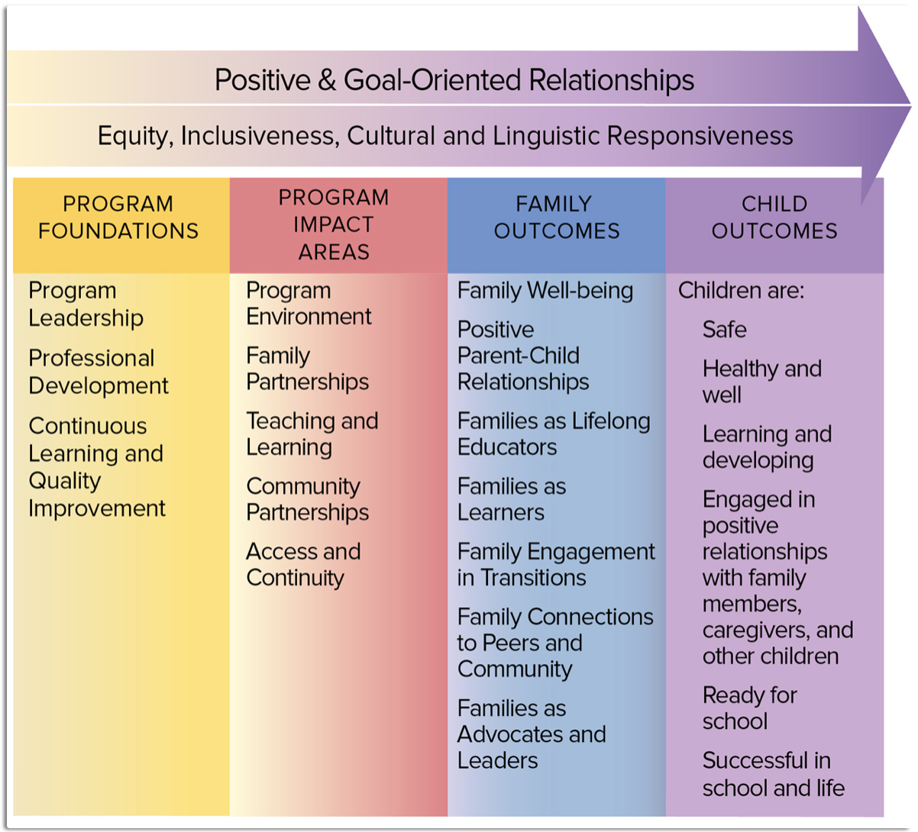
Head Start’s Parent, Family and Community Engagement (PFCE) Framework
Notes:
We will also use Head Start’s Parent, Family and Community Engagement (PFCE) Framework throughout the next two days. Each column of the PFCE Framework represents an area to guide critical thinking and strategic planning towards meeting their fatherhood engagement requirements.

Slide 5
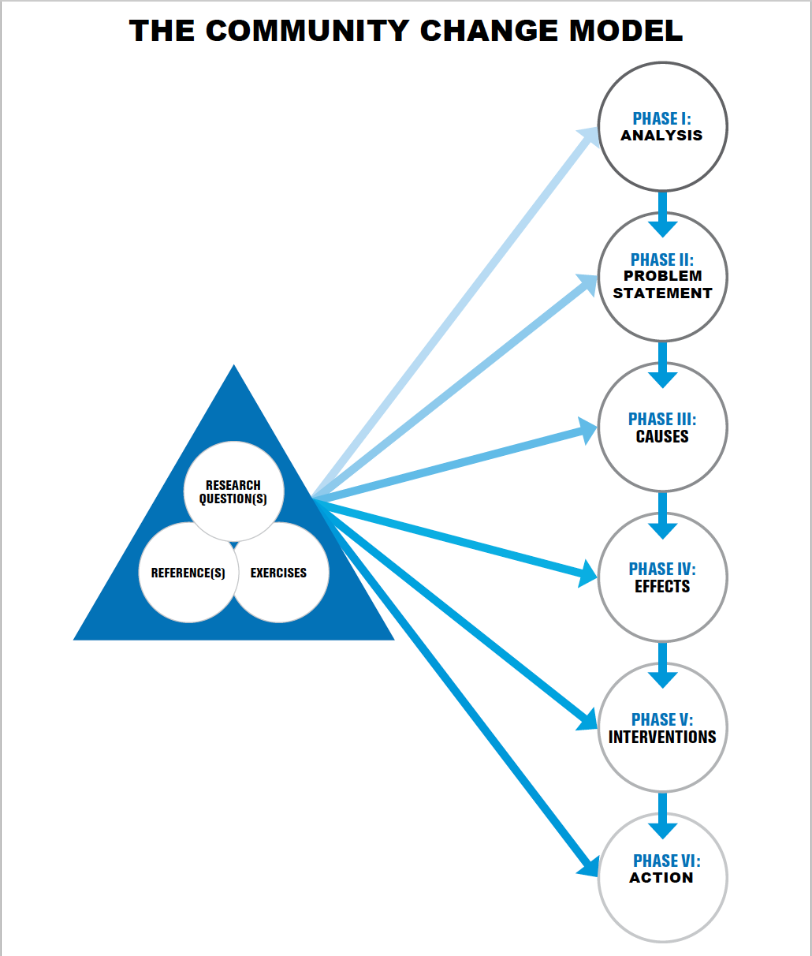
Notes:
Today’s and tomorrow’s workshops have been designed using our Community Change Model. This is our approach to analyize and address any problem of concern. It involves the integration of three components (questions – statement of inquiry; references – sources of information that provides answers to the questions; and exercises – activities that engage participants in exploring references and expressing their findings). These three components navigate six sequential phases towards preparing communities to make informed decisions and to take strategic action towards effectively addressing their issue of concern. Ultimately, the Community Change Model builds the capacity of individuals and organizations to engage in critical thinking, research, and strategic planning towards becoming effective leaders of their community. Today, we will apply the first five phases of the Community Change Model to the selected issue of barriers to father engagement.

Slide 6
PHASE I – SELF-ANALYSIS PART 1/2: participants will gain information on the sponsors and presenters of this workshop, as well as its other participants.
QUESTIONS
Who are we? (Community Change, Inc.)
What is this initiative?
Why is this initiative important?
What should I expect from this initiative?
  To involve participants in critical thinking and strategic planning towards achieving optimal father engagement for their program and agency.
Notes:
REFERENCES
Community Change, Inc.’s website https://communitychangeinc.com
The Head Start Policy Regulations - (Part 1302.50 - Family Engagement)? https://eclkc.ohs.acf.hhs.gov/policy/45-cfr-chap-xiii/1302-50-family-engagement Family engagement approach. A program must: (1) Recognize parents as their children’s primary teachers and nurturers and implement intentional strategies to engage parents in their children’s learning and development and support parent-child relationships, including specific strategies for father engagement.
EXERCISE (10 minutes)
The facilitator will go through the website to explain Community Change, Inc., the services it provides and its Community Change Model as the company’s approach to problem-solving approach through inquiry (questions), research (references) and practice (exercises). There are six phases to this approach: 1. Self Analysis 2. Problem Statement (including defining the issue of concern) 3. Causes 4. Effects 5. Intervention 6. Action. The goal of this approach is to promote critical thinking and strategic planning towards developing people into effective leaders of their community.

Slide 7
PHASE I – SELF-ANALYSIS PART 2/2: participants will gain information on the sponsors and presenters of this workshop, as well as its other participants.
QUESTIONS
What’s your name? What’s your title?
What is your agency?
What is its vision?
Its mission?
It primary services?
EXERCISE
Elevator Pitch! In pairs, participants will go into breakout rooms, each will be allowed 30 seconds each (1 minute total) to respond to the five questions listed. Answer the questions as if you are talking to a father you are hoping to get involved in your program, and let’s see how well you do!
Notes:
REFERENCES: participants; agency brochures/websites
EXERCISE 2 (20 minutes)
Elevator Pitch! The host will shuffle and pair participants into breakout rooms, allowing them 30 seconds each (1 minute total) to respond to the five questions listed as if you are talking to a father you are hoping to get involved in your program. Once one minute has elapsed, the host will shuffle again until participants have had five opportunities to give their elevator pitch. Host will then lead a large group discussion, where participants will share common/similar responses, and the importance of knowing this information.

Slide 8

PHASE I – SELF-ANALYSIS FINDINGS
Head Start, under the auspices of the New York City Department of Education, seeks to support its contracted agencies in satisfying its federal mandates related to father engagement. Community Change, Inc. (CCI) is a capacity building firm that provides a range of programs that serve K-12 youth, parents, staff and organizations. All of CCI’s services promotes critical thinking, research and strategic planning in the areas of community, careers, culture, relationships and finances. CCI will lead this two-day workshop series. Participants of this workshop are comprised of different people, from different agencies, with different philosophies, that provide a range of services for youth, families, communities throughout New York.
TAKE-AWAYS!!!
Please type in the chat any take-aways from this exercise/phase that you will be able to use at your program/agency after this workshop.

Slide 9
  PHASE II – PROBLEM STATEMENT, PART 1/6: Participants will explore ways to determine the needs, interests and concerns of the fathers in their community.
QUESTIONS
How do you assess what is appropriate for engaging your fathers?
How do you assess the strengths, needs, interests and concerns of your fathers?
What are the needs interests and concerns of fathers in your community? Where are the gaps in services?
EXERCISE 10 (30 minutes)
Participants will watch the movie trailer, and then be broken into their Framework Team, where they will review the references and then construct a needs assessment for their fathers. Within their team, participants will determine 1. What questions they will ask (limit 5) 2. How will they gain access to the fathers to distribute and collect the survey? And 3. How will they use the information? Teams will share one key take-away with the large group.
Notes:
REFERENCES:
Engaging Fathers in Head Start
https://www.fatherhood.gov/sites/default/files/resource_files/e000001785.pdf
Seven Steps for Conducting a Successful Needs Assessment https://www.nichq.org/insight/seven-steps-conducting-successful-needs-assessment
Responses from needs assessment (https://docs.google.com/forms/d/118KjOPQAkcG4aCgGXIxa9JME_8TGJg5wgJIyTrFuCeQ/edit#responses)
RESOURCES:
Fatherhood Movie Trailer (https://www.youtube.com/watch?v=3AImOf9Fuh4)
EXERCISE 10 (30 minutes)
Participants will watch the movie trailer, and then be broken into their Framework Team, where they will review the references and then construct a needs assessment for their fathers. Within their team, participants will determine 1. What questions they will ask (limit 5) 2. How will they gain access to the fathers to distribute and collect the survey? And 3. How will they use the information? Teams will share one key take-away with the large group.

Slide 10
  PHASE II – PROBLEM STATEMENT, PART 1/6: Before engaging your target population, it is important to understand their needs, interests and concerns, as well as what is appropriate to them. You will gain this understanding by conducting formal and informal needs assessments. These assessments should include primary and secondary sources from both the target population as well as from key informants. This will help you to make adjustments in your marketing and service plans towards ensuring their awareness and engagement in your programs.
  TAKE-AWAYS!!!
  Please type in the chat any take-aways from this exercise/phase that you will be able to use at your program/agency after this workshop.

Slide 11
  PHASE II – PROBLEM STATEMENT, PART 2/6: Participants will gain knowledge of various definitions of father engagement.
QUESTION
What is father engagement?
EXERCISE
Reciprocal Reading. The host will create four breakout groups, (1. Foundations 2. Impact 3. Family Outcomes and 4. Child Outcomes) each assigned to one of the listed references. Each group will 1. Read the assigned reference, and 2. summarize the definition to share with the large group.
Notes:
REFERENCES:
Father Engagement in Human Services, Mathematica https://aspe.hhs.gov/sites/default/files/2021-09/keep-5.2.2-infographic.pdf
Why Fatherhood Engagement Matters
https://www.all4kids.org/news/blog/why-fatherhood-engagement-matters/
Birth to 5 Father Engagement Guide
https://eclkc.ohs.acf.hhs.gov/family-engagement/birth-5-father-engagement-guide/birth-5-father-engagement-guide
Head Start Father Engagement Birth to Five Programming Guide, page 1 “Understanding Father Involvement and Engagement in Head Start” https://www1.nyc.gov/assets/acs/pdf/hoot_mail/HEADSTART_Father_Engagement.pdf
EXERCISE 3 (30 m)
Reciprocal Reading. The host will create four breakout groups, each assigned to one of the listed references. Each group will 1. Read the assigned reference, and 2. summarize the definition to share with the large group.

Slide 12
  PHASE II – PROBLEM STATEMENT PART 2/6: FINDINGS.
There are different definitions for father engagement. It is important to each agency to be clear about what it is trying to do in terms of father engagement, based on the definitions:
Father involvement – getting male parents to be present in the child’s physical learning environment (i.e. dads attending special events or field trips)
Father collaboration - getting male parents to partner/work with programs to develop their child(ren) (i.e. dads helping child with homework using resources provided by the program)
Father support – providing services to address the specific needs, interest and/or concerns of male parents (i.e. workshops specifically for fathers to address any range of relationship, education, economics and/or legal issues).
TAKE-AWAYS!!!
Please type in the chat any take-aways from this exercise/phase that you will be able to use at your program/agency after this workshop.

Slide 13
  PHASE II – PROBLEM STATEMENT, PART 3/6: Participants will gain knowledge of various definitions of father engagement and the relevant Head Start regulations and requirements.
QUESTIONS
What are the requirements? As a program leader? As a family worker?
Why is father engagement important? To you as a program leader? To you as a family worker? To the fathers you serve. To the children you serve.
What is your vision for father engagement? As a program leader? As a family worker?
What is your reality for father engagement? As a program leader? As a family worker?
EXERCISE
Visions/Reality Collage. Take a few moments to review the references. Create a collage to express your responses to questions 3 and 4 using your choice of fotor.com, canva.com, or a Word document. Identify images that represent what you see as your vision and reality of father engagement (informed by the definition of your choosing from the previous exercise) in your program. Please be prepared to share.
Notes:
REFERENCES:
The Head Start Policy Regulations - (Part 1302.50 - Family Engagement)? https://eclkc.ohs.acf.hhs.gov/policy/45-cfr-chap-xiii/1302-50-family-engagement - Family engagement approach. A program must: (1) Recognize parents as their children’s primary teachers and nurturers and implement intentional strategies to engage parents in their children’s learning and development and support parent-child relationships, including specific strategies for father engagement;
The Father Absence Crisis in America Infographic https://cdn2.hubspot.net/hubfs/135704/NFIFatherAbsenceInfoGraphic071118.pdf
Participants
RESOURCE: 1. fotor.com 2. canva.com
EXERCISE 4. (30 minutes)
Visions/Reality Collage. After taking a few moments to review the references and discussing as a large group their responses to questions 1 and 2, participants will work individual to create collages to express their responses to questions 3 and 4. Using their choice of fotor.com, canva.com, or a word document, participants will identify images that represent what they see as their vision and reality of father engagement (informed by the definition from the previous exercise) in their program and agency.

Slide 14
  PHASE II – PROBLEM STATEMENT PART 3/6: FINDINGS.
The gap separating your vision and reality is known as a creative tension. Therein is an opportunity for innovation, enhancement and expansion strategies. This will require ongoing critical thinking and strategic planning. This workshop is engaging you in this process on an introductory level. It will be important to dedicate time and resources continue this process intently beyond this workshop, when your return to your home agencies, in order to make your vision a reality.
TAKE-AWAYS!!!
Please type in the chat any take-aways from this exercise/phase that you will be able to use at your program/agency after this workshop.

Slide 15

SHORT BREAK
Notes:
Engaging Fathers (7 minutes) https://eclkc.ohs.acf.hhs.gov/video/engaging-fathers
Glory ft. Blue Ivy https://www.youtube.com/watch?v=vyoNdZxy5VE
Lukas Graham - 7 Years https://www.youtube.com/watch?v=LHCob76kigA

Slide 16
ICEBREAKER
In one minute, type or write as many words out of the phrase “father engagement” as you can.

Slide 17
  PHASE II – PROBLEM STATEMENT, PART 4/6: Participants will examine their program’s internal and external environments.
QUESTIONS
What people, places and other things make up your program’s internal and external environment?
What are the factors/conditions in your environment that affect father engagement for your program?
What/who are the supports to your program realizing your vision for father engagement? As a program leader? As a family worker?
EXERCISES
Environmental Scan. Individually or collaboratively with co-workers, participants will conduct an environmental scan of their Head Start program.
Notes:
REFERENCE: participants
RESOURCE: www.coggle.it
EXERCISES (30 mins.)
Environmental Scan. Individually or collaboratively with co-workers, participants will go to www.coggle.it to create an account and sign-in to this web-based, brainstorming app. They will type the heading Environmental Scan of (THEY WILL INSERT THEIR PROGRAM’S NAME HERE), and then click on the plus sign on the perimeter of the Environmental Scan box to create a “People” category. They will click on the plus sign on another side of the Environmental Scan perimeter to create a “Places” category. Finally, they will click on another side of the Environmental Scan perimeter to create a “Other Things” category. For each category participants created, they will hover over it to add a branch, which will be an item that relates to that category in response to each of the assigned questions for this exercise. Host will field three volunteers to share the items they listed under one of the categories.

Slide 18
  PHASE II – PROBLEM STATEMENT PART 4/6: FINDINGS.
It is important to be aware of the elements and conditions in which your program operate in order to develop and implement an effective strategy for father engagement. This environment will vary from agency to agency. Once identified, program leaders and family workers can build and leverage relationships with proponents to achieve father engagement goals.
TAKE-AWAYS!!!
Please type in the chat any take-aways from this exercise/phase that you will be able to use at your program/agency after this workshop.

Slide 19
LONG BREAK
Notes:
All of the lights https://www.youtube.com/watch?v=HAfFfqiYLp0
Just the two of us” https://www.youtube.com/watch?v=_WamkRSDeD8

Slide 20
  PHASE II – PROBLEM STATEMENT, PART 5/6: Participants will examine some general barriers to father engagement for Head Start Programs.
QUESTION
What are some barriers to father engagement for Head Start Programs?
EXERCISE
Group Reading, Summarize and Share. In groups, participants will read, summarize and share the key points from the articles shared with them.
Notes:
REFERENCES:
Engaging Fathers in Head Start, https://www.fatherhood.gov/sites/default/files/resource_files/e000001785.pdf
Six Obstacles to Father Involvement—and How to Overcome Them https://greatergood.berkeley.edu/article/item/six_obstacles_to_father_involvementand_how_to_overcome_them
The Power of Fathers https://www.irvingharrisfdn.org/wp-content/uploads/2021/01/Father-Engagement-Concept-Paper-FINAL.pdf
Fathers’ Perspectives on Supports and Barriers That Affect Their Fatherhood Role (pages 7 – 9)
https://journals.sagepub.com/doi/pdf/10.1177/2158244014521818
EXERCISE 6 (30 minutes).
Group Reading, Summarize and Share. The host will break participants into four groups (1. Foundations 2. Impact 3. Family Outcomes and 4. Child Outcomes) Each group will have five minutes to read, summarize and share the key points from each section of the article.
Foundations group will read, summarize and share the “Barriers to Change” section.
Impacts group will read, summarize and share the “Assess Strengths and Challenges” section.
Family Outcomes group will read, summarize and share the “Implementing Change” section.
Child Outcomes group will read, summarize and share the “Programming for Father Involvement” section.

Slide 21
  PHASE II – PROBLEM STATEMENT PART 5/6: FINDINGS.
There are a myriad of barriers to implementing an effective father engagement strategies. It is important for program leaders and family workers to understand the barriers that affect their efforts, and to be realistic about what barriers they can effectively address.
TAKE-AWAYS!!!
Please type in the chat any take-aways from this exercise/phase that you will be able to use at your program/agency after this workshop.

Slide 22
  PHASE II – PROBLEM STATEMENT, PART 6/6: Participants will examine some barriers to father engagement for New York City Head Start Programs.
QUESTIONS
What are the common barriers to father engagement in New York City?
EXERCISE
Bingo! Each participant will click on the link (https://mfbc.us/m/m94bb83) for their bingo card. The Bingo card was populated with responses from the needs assessment to the question What are three of the greatest challenges you have had in integrating specific strategies for father engagement into your program? The host will call out items on the list. Participants will click on each item as they are called out. The first participant with a crossed out item under each of the BINGO letters wins! With this victory, they get to discuss their challenges with father engagement. Repeat game if time allows.
Notes:
REFERENCES:
Participants responses from needs assessment (https://docs.google.com/forms/d/118KjOPQAkcG4aCgGXIxa9JME_8TGJg5wgJIyTrFuCeQ/edit#responses)
RESOURCE: My Free Bingo https://myfreebingocards.com/bingo-card-generator/free/fasqpvt
EXERCISE 7 (30 minutes). Bingo! Each participant will click on the link (https://mfbc.us/m/m94bb83) for their bingo card (if more than 30 participants, then break them up into their four assigned Framework groups to play as four teams, with each team getting a preselected card that is put in the chat by the host. The host will select the four cards using the “Individual” option on the bingo generator page). The Bingo card was populated with responses from the needs assessment to the question What are three of the greatest challenges you have had in integrating specific strategies for father engagement into your program? The host will call out items on the list. Participants will click on each item as they are called out. The first participant with a crossed out item under each of the BINGO letters wins! With this victory, they get to discuss their challenges with father engagement. Repeat game if time allows.

Slide 23
  PHASE II – PROBLEM STATEMENT PART 6/6: FINDINGS.
Many internal and external elements of a program’s environment determines the barriers that they face in implementing their father engagement strategies. After defining their father engagement intentions, and scanning their environment, each program must identify the unique and most significant challenges they face as part of the process of developing their strategic plan of action.
TAKE-AWAYS!!!
Please type in the chat any take-aways from this exercise/phase that you will be able to use at your program/agency after this workshop.

Slide 24
SHORT BREAK
Notes:
Engaging Fathers (7 minutes) https://eclkc.ohs.acf.hhs.gov/video/engaging-fathers
Glory ft. Blue Ivy https://www.youtube.com/watch?v=vyoNdZxy5VE
Lukas Graham - 7 Years https://www.youtube.com/watch?v=LHCob76kigA

Slide 25
  PHASE III – CAUSES & PHASE IV - EFFECTS: Participants will examine the things that lead to the barriers to father engagement, as well as the things that happen as a result of those barriers.
QUESTIONS
What are the causes of the most significant barriers to father engagement in your program?
What are the effects of the most significant barriers to father engagement in your program?
EXERCISE
Speed Dating Challenges.
Of the listed challenges from the previous BINGO game, participants will choose three that relate to their program their most. They will then go online to research the causes and effects of those challenges. Afterwards, participants will be randomly paired and shuffled to discuss the challenges they researched. Participants will track the number of participants they are paired with who has at least one of their challenges in common. Whoever has the highest number of people who shares the same challenge as they to wins!
Notes:
REFERENCES:
Participants
Findings from participant research
EXERCISE (30 minutes)
Speed Dating Challenges. The host will open this exercise by explaining the significance of identifying the causes and effects of an issue before exploring possible interventions. The causes and effects, once identified, can be the targets of strategies for change. Participants will be asked to copy the Bingo list of issues and paste them on a separate word document. Each participant will choose up to three challenges to engaging fathers from this list that resonate with them the most. They will each then be given 10 minutes to go online find and make note of as many of the causes and effects of those barriers as possible to share their findings. Once the 10 minutes has elapsed, the host will then shuffle the participants into pairs, where they will have a total of two minutes (one minute each participant), to discuss the challenges they researched. Participants will track the number of participants they are paired with who has at least one of their challenges in common. Whoever has the highest number of people who shares the same challenge as they to wins!

Slide 26
  PHASE III – CAUSES & PHASE IV - EFFECTS: FINDINGS.
Causes are the things to lead to something. Effects are the things that happen as a result of something. Many of the participants are experiencing the same challenges to implementing father engagement strategies. There are many causes and effects of the barriers to father engagement. Awareness of the causes and effects allows programs to target their interventions to limit the impact and ultimately overcome the barriers to implementing their father engagement strategy.
TAKE-AWAYS!!!
Please type in the chat any take-aways from this exercise/phase that you will be able to use at your program/agency after this workshop.

Slide 27
REVIEW
Notes:
To review, participants will play a game of Jeopardy!. The facilitator will open the link, found at: https://www.triviamaker.com/game-preview/game/GD20220306164657993645951-Breaking-Down-the-Barriers-to-Father-Engagement!!!
After opening the link, the faciliator will share his screen and then ask the groups to compete as their preassigned team. Each team will take turns sending representatives to choose the category from which they’d like to field questions. For every correct answer, they score points; for every incorect answer, they lose points. The team with the most points once all of the categories have been unconvered wins!!!

Slide 28

Notes:
To review, participants will play a game of Jeopardy!. The facilitator will open the link, found at: https://www.triviamaker.com/game-preview/game/GD20220306164657993645951-Breaking-Down-the-Barriers-to-Father-Engagement!!!
After opening the link, the faciliator will share his screen and then ask the groups to compete as their preassigned team. Each team will take turns sending representatives to choose the category from which they’d like to field questions. For every correct answer, they score points; for every incorect answer, they lose points. The team with the most points once all of the categories have been unconvered wins!!!

Slide 29
NEXT STEPS

Slide 30
ROSE & THORN REFLECTION
Notes:
Participants will volunteer to share their roses (things they enjoyed) and thorns (things that they did not enjoy) about today’s workshop, and offer suggestions for improvement.

Slide 31
FEEDBACK
Please visit the following link to provide your anonymous feedback.
https://docs.google.com/forms/d/1G7LgYCcmkb-JyXAVzYE3KFk4z3Ue19XKLv3iRK3eCEQ/edit
Please respond critically and honestly, as doing so will help us to improve. Note that the feedback form is organized into three categories: 1. Exercises 2. References/Resources and 3. Facilitation.
Notes:
Facilitator will drop the link in the chat so that participants can provide their feedback:
https://docs.google.com/forms/d/1G7LgYCcmkb-JyXAVzYE3KFk4z3Ue19XKLv3iRK3eCEQ/edit

Slide 32
RESOURCES
Birth to 5 Father Engagement Guide https://eclkc.ohs.acf.hhs.gov/family-engagement/birth-5-father-engagement-guide/birth-5-father-engagement-guide
Community Change, Inc.’s website https://communitychangeinc.com
Creating Father-Friendly Environments in Early Childhood Programs https://eclkc.ohs.acf.hhs.gov/sites/default/files/pdf/bt5-feg-creating-father-friendly-environments-in-early-childhood-programs.pdf
Engaging Fathers in Head Start, https://www.fatherhood.gov/sites/default/files/resource_files/e000001785.pdf
Father Engagement in Human Services, Mathematica https://aspe.hhs.gov/sites/default/files/2021-09/keep-5.2.2-infographic.pdf
Head Start Father Engagement Birth to Five Programming Guide, page 1 “Understanding Father Involvement and Engagement in Head Start” https://www1.nyc.gov/assets/acs/pdf/hoot_mail/HEADSTART_Father_Engagement.pdf
Participants responses from needs assessment https://docs.google.com/forms/d/118KjOPQAkcG4aCgGXIxa9JME_8TGJg5wgJIyTrFuCeQ/edit#responses
Professional Development Strategies That Promote Father Engagement https://eclkc.ohs.acf.hhs.gov/sites/default/files/pdf/bt5-feg-professional-development-strategies-promote-father-engagement.pdf
Program Strategies to Maximize Fathers’ Connections With Community Partners https://eclkc.ohs.acf.hhs.gov/sites/default/files/pdf/bt5-feg-program-strategies-maximize-fathers-connections-community-partners.pdf
Six Obstacles to Father Involvement—and How to Overcome Them https://greatergood.berkeley.edu/article/item/six_obstacles_to_father_involvementand_how_to_overcome_them

Slide 33
RESOURCES
(continued)
Program Strategies to Promote Father Engagement in Their Children’s Teaching and Learning https://eclkc.ohs.acf.hhs.gov/sites/default/files/pdf/bt5-feg-program-strategies-promote-father-engagement-childrens-teaching-learning.pdf
Program Strategies to Provide Access and Continuity of Services to Fathers https://eclkc.ohs.acf.hhs.gov/sites/default/files/pdf/bt5-feg-program-strategies-provide-access-continuity-services-fathers.pdf
Strategies for Program Leaders to Support Father Engagement https://eclkc.ohs.acf.hhs.gov/sites/default/files/pdf/bt5-feg-strategies-for-program-leaders-support-father-engagement.pdf
Strategies to Build Partnerships with Fathers https://eclkc.ohs.acf.hhs.gov/sites/default/files/pdf/bt5-feg-strategies-to-build-partnership-fathers.pdf
The Father Absence Crisis in America Infographic https://cdn2.hubspot.net/hubfs/135704/NFIFatherAbsenceInfoGraphic071118.pdf
The Head Start Policy Regulations - (Part 1302.50 - Family Engagement)? https://eclkc.ohs.acf.hhs.gov/policy/45-cfr-chap-xiii/1302-50-family-engagement
Why Fatherhood Engagement Matters https://www.all4kids.org/news/blog/why-fatherhood-engagement-matters/
The Power of Fathers https://www.irvingharrisfdn.org/wp-content/uploads/2021/01/Father-Engagement-Concept-Paper-FINAL.pdf
Fathers’ Perspectives on Supports and Barriers That Affect Their Fatherhood Role (pages 7 – 9) https://journals.sagepub.com/doi/10.1177/2158244014521818

Slide 34
RESOURCES
(continued)
The Community Change Model Blueprint https://communitychangeinc.com/wp-content/uploads/2019/09/9a.-The-Community-Change-Model.pdf
Head Start Parent, Family, and Community Engagement Framework: An Overview for Parents https://eclkc.ohs.acf.hhs.gov/sites/default/files/pdf/hs-pfce-framework-overview-for-parents-eng.pdf

