Slide 1



Strategies and Resources for Father Engagement
Wednesday, May 11, 2022
9:00 a.m. – 3:00 p.m.
Notes:
Meeting link: https://meet.google.com/djj-iesj-vbx
RESOURCES
Cat’s in the Cradle https://www.youtube.com/watch?v=KUwjNBjqR-c
Beyonce – Daddy. https://www.youtube.com/watch?v=0VyY_sXW6zk
Your Daddy Loves You https://www.youtube.com/watch?v=sD9Ku5qEPjQ
Luther Vandross - Dance With My Father https://www.youtube.com/watch?v=wmDxJrggie8
Beyonce - Daddy Lessons https://www.youtube.com/watch?v=ZRn6oTAdMGs

Slide 2
PRE-WORKSHOP TASKS
WHAT TO READ
The Community Change Model Blueprint https://communitychangeinc.com/wp-content/uploads/2019/09/9a.-The-Community-Change-Model.pdf, pages 16-22
Seven Steps for Conducting a Successful Needs Assessment https://www.nichq.org/insight/seven-steps-conducting-successful-needs-assessment
Head Start Parent, Family, and Community Engagement Framework: An Overview for Parents https://eclkc.ohs.acf.hhs.gov/sites/default/files/pdf/hs-pfce-framework-overview-for-parents-eng.pdf
Responses from needs assessment https://docs.google.com/forms/d/118KjOPQAkcG4aCgGXIxa9JME_8TGJg5wgJIyTrFuCeQ/edit#responses
WHAT TO ASK YOURSELF
What are three strategies your program has implemented related to father engagement? If you have not implemented any strategies yet, consider the reasons why. It will inform how we approach the last half of our full day workshop.

Slide 3
TODAY’S AGENDA
Welcome to “Strategies and Resources for Father Engagement”
Phase V: Interventions
  What is Head Start’s Parent & Community Engagement Framework?
  What have been some father engagement strategies that have worked? Have not worked?
  What resources are needed to implement effective father engagement strategies? How do I find them?
Phase VI: Action
  What are my next steps towards innovating, replicating, enhancing and/or expanding our father engagement strategies and securing the necessary resources?
Close
Notes:
As with yesterday’s workshop, today’s session is designed using our Community Change Model. This is our approach to analyize and address any problem of concern. It involves the integration of three components (questions – statement of inquiry; references – sources of information that provides answers to the questions; and exercises – activities that engage participants in exploring references and expressing their findings). These three components navigate six sequential phases towards preparing communities to make informed decisions and to take strategic action towards effectively addressing their issue of concern. Ultimately, the Community Change Model builds the capacity of individuals and organizations to engage in critical thinking, research, and strategic planning towards becoming effective leaders of their community. Today, we ill apply the last two phases of the Community Change Model to the selected issue of barriers to father engagement.

Slide 4
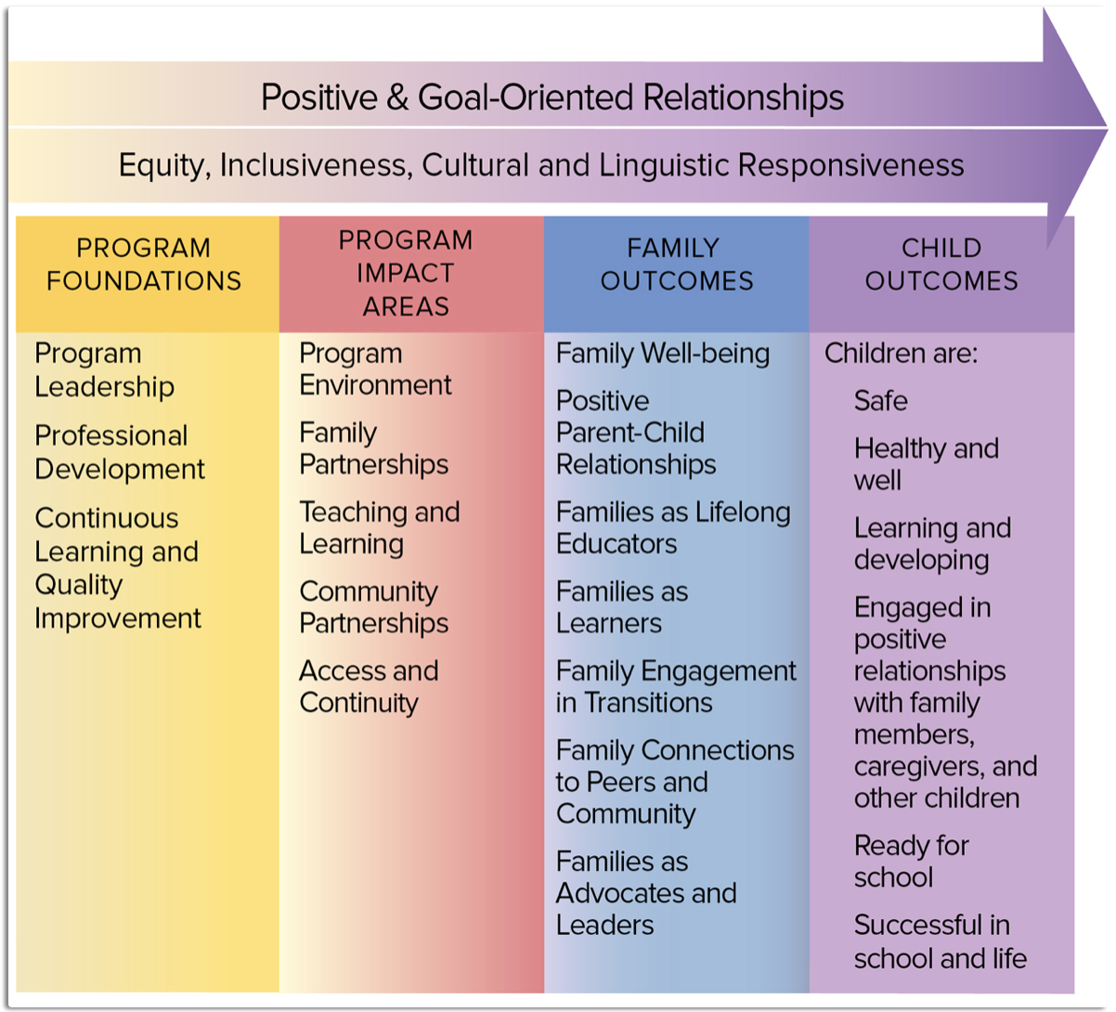
Head Start’s Parent, Family and Community Engagement (PFCE) Framework
Notes:
We will also use Head Start’s Parent, Family and Community Engagement (PFCE) Framework throughout the next two days. Each column of the PFCE Framework represents an area to guide critical thinking and strategic planning towards meeting their fatherhood engagement requirements.

Slide 5
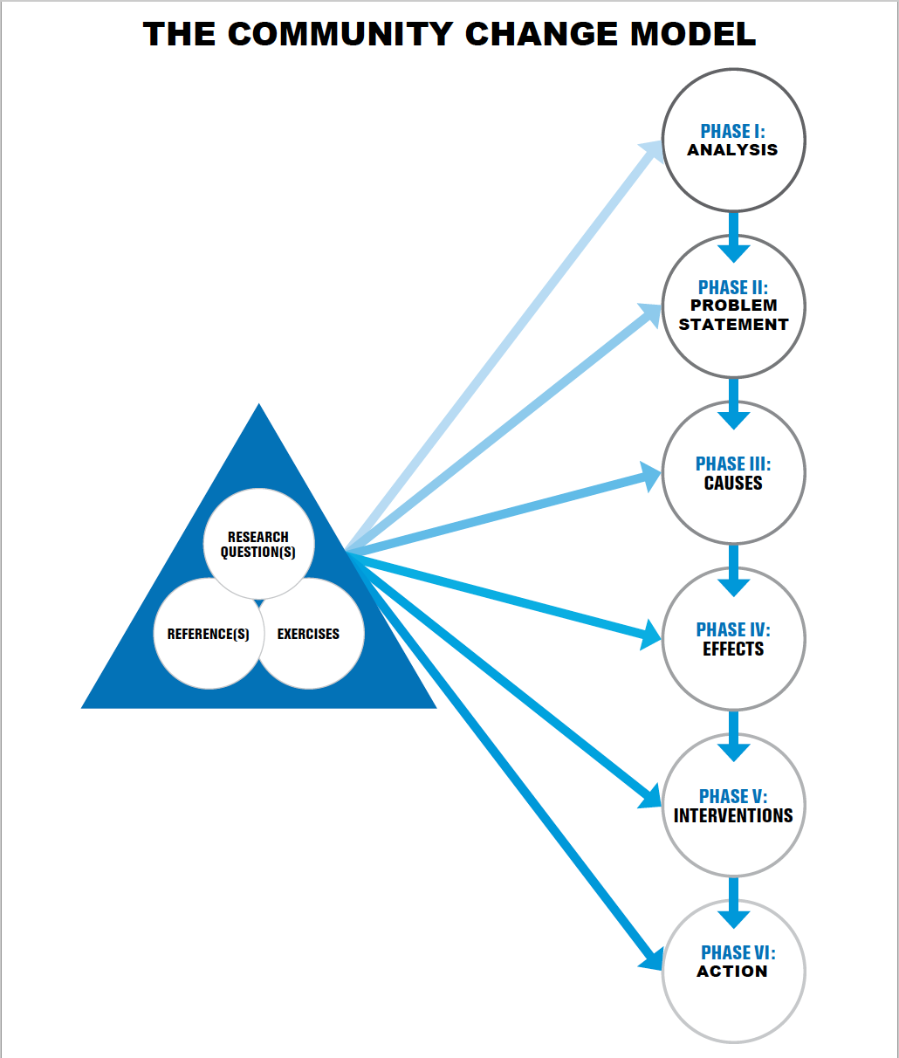
Notes:
As with yesterday’s workshop, today’s session is designed using our Community Change Model. This is our approach to analyize and address any problem of concern. It involves the integration of three components (questions – statement of inquiry; references – sources of information that provides answers to the questions; and exercises – activities that engage participants in exploring references and expressing their findings). These three components navigate six sequential phases towards preparing communities to make informed decisions and to take strategic action towards effectively addressing their issue of concern. Ultimately, the Community Change Model builds the capacity of individuals and organizations to engage in critical thinking, research, and strategic planning towards becoming effective leaders of their community. Today, we ill apply the last two phases of the Community Change Model to the selected issue of barriers to father engagement.

Slide 6


Slide 7
PHASE 5 – INTERVENTIONS: participants will increase their understanding about Head Start’s Parent, Family, and Community Engagement Framework.
QUESTIONS
What is the PFCE Framework?
  What are the program foundations of the PFCE Framework?
  What are the program impact areas of the PFCE Framework?
  What are the family outcomes of the PFCE Framework?
  What are the child outcomes of the PFCE Framework?
How does the framework relate to father engagement?
EXERCISE: The People’s Court. Each Framework team will convene to review and research information (15 minutes) to make a case, with evidence, to explain what their assigned component of the Framework is, why is it so important (3-5 minutes each) to father engagement, and why it should receive the most focus of the organization’s resources. They may call on witnesses from their own group to make their case. The judge and jury will be a panel of volunteer participants who will decide which team will win, based on the strength of their argument.
Notes:
REFERENCE: Head Start Parent, Family, and Community Engagement Framework: An Overview for Parents https://eclkc.ohs.acf.hhs.gov/sites/default/files/pdf/hs-pfce-framework-overview-for-parents-eng.pdf
EXERCISE 11 (45 minutes) The People’s Court. Each Framework team will convene to review and research information (15 minutes) make a case, with evidence, to explain what their assigned component of the Framework is, why is it so important (3-5 minutes each) to father engagement, and why it should receive the most focus of the organization’s resources. They may call on witnesses from their own group to make their case. The judge and jury will be a panel of volunteer participants who will decide which team will win, based on the strength of their argument.

Slide 8

Notes:
The host must take a screenshot of the answers before starting this game. The host will click the link, then click “Play Game”. Then, the host will click “Launch Game” under the “Basic” option. The host will explain the participants that all of the answers and the points for each are based on the responses and percentages of the answers the program leaders and family workers gave for the needs assessment last month. Each team will be separated into a breakout room and have one minute to assign a different number beginning with one in an ascending sequence to each of their members. Once done, the teams will return to the main meeting room to begin the game. At the start of each round, the host will call out a number. Only the participant from each team who is assigned to the number called will compete in that round. The host will click the “Q” icon to call up the question. As soon as the question appears, they should type their response. The participants will be advised that the first person who types in the chat the answer with the highest point, wins those points. Referring to the screenshot of the answers, the host clicks on the “A” icon to reveal the hidden responses as the correct answers are given. The next numbered participant in the sequence from their team with the will be able to respond. The team with the most points after all five rounds wins!!!

Slide 9
PHASE 5 – INTERVENTIONS: participants will increase their understanding about Head Start’s Parent, Family, and Community Engagement Framework.
P5 QUESTIONS
In what borough is your program?
In which of the PFCE Interactive Framework’s program impact areas would you like more support?
In which of the PFCE Interactive Framework’s program foundation areas would you like more support?
In which of the PFCE Interactive Framework’s family outcome areas would you like more support?
In which of the PFCE Interactive Framework’s child outcome areas would you like more support?
EXERCISE Family Feud. The host will break the participants into four groups or teams, according to the PFCE Framework:
Team 1 = Foundations; Team 2 = Impacts; Team 3 = Family Outcomes
Team 4 = Child Outcomes
Each team will be separated into a breakout room and have one minute to assign a different number beginning with one in an ascending sequence to each of their members. Once done, the teams will return to the main meeting room to begin the game. At the start of each round, the host will call out a number. Only the participant from each team who is assigned to the number called will compete in that round. The host will click the “Q” icon to call up the question. As soon as the question appears, they should type their response. The participants will be advised that the first person who types in the chat the answer with the highest point, wins those points. The next numbered participant in the sequence from their team with then will be able to respond. The team with the most points after all five rounds wins!!!
Notes:
REFERENCES
Participants
Responses from needs assessment (https://docs.google.com/forms/d/118KjOPQAkcG4aCgGXIxa9JME_8TGJg5wgJIyTrFuCeQ/edit#responses)
RESOURCE: Trivia Maker: https://www.triviamaker.com/game-preview/game/FF20220227164594306974264-Father-Engagement-Strategies
EXERCISE 13 (20 minutes): Family Feud. Prior to the game, the host should practice the game controls, and get a snapshot of the hidden answers for each round. The host will break the participants into four groups or teams, according to the PFCE Framework:
Team 1 = Foundations; Team 2 = Impacts; Team 3 = Family Outcomes
Team 4 = Child Outcomes
The host must take a screenshot of the answers before starting this game. The host will click the link, then click “Play Game”. Then, the host will click “Launch Game” under the “Basic” option. The host will explain the participants that all of the answers and the points for each are based on the responses and percentages of the answers the program leaders and family workers gave for the needs assessment last month. Each team will be separated into a breakout room and have one minute to assign a different number beginning with one in an ascending sequence to each of their members. Once done, the teams will return to the main meeting room to begin the game. At the start of each round, the host will call out a number. Only the participant from each team who is assigned to the number called will compete in that round. The host will click the “Q” icon to call up the question. As soon as the question appears, they should type their response. The participants will be advised that the first person who types in the chat the answer with the highest point, wins those points. Referring to the screenshot of the answers, the host clicks on the “A” icon to reveal the hidden responses as the correct answers are given. The next numbered participant in the sequence from their team with the will be able to respond. The team with the most points after all five rounds wins!!!

Slide 10

PHASE 5 – INTERVENTIONS: FINDINGS
Head Start’s PFCE Framework covers the most significant areas an organization should consider when developing strategies for father engagement. There is value to each area, and an organization should consider each one as they develop their father engagement strategy.
TAKE-AWAYS!!!
Please type in the chat any take-aways from this exercise/phase that you will be able to use at your program/agency after this workshop.

Slide 11
PHASE 5 – INTERVENTIONS: participants will increase their knowledge of strategies for father engagement in each area of Head Start’s Parent, Family, and Community Engagement Framework.
P5 QUESTIONS
How is father engagement manifested in each area of the framework?
What is your father engagement goal and strategy in each area?
EXERCISE Framework Panel Discussion. In small groups, each Framework Team will review two of the listed references of their choice. The representatives will identify the framework area covered by each article, and be prepared to discuss as part of the large group discussion in response to the two listed questions.
Notes:
REFERENCES
Program Strategies to Provide Access and Continuity of Services to Fathers (Impacts)
https://eclkc.ohs.acf.hhs.gov/sites/default/files/pdf/bt5-feg-program-strategies-provide-access-continuity-services-fathers.pdf
Program Strategies to Maximize Fathers’ Connections With Community Partners (Impacts)
https://eclkc.ohs.acf.hhs.gov/sites/default/files/pdf/bt5-feg-program-strategies-maximize-fathers-connections-community-partners.pdf
Program Strategies to Promote Father Engagement in Their Children’s Teaching and Learning (Child Outcomes)
https://eclkc.ohs.acf.hhs.gov/sites/default/files/pdf/bt5-feg-program-strategies-promote-father-engagement-childrens-teaching-learning.pdf
Strategies to Build Partnerships with Fathers (Impacts)
https://eclkc.ohs.acf.hhs.gov/sites/default/files/pdf/bt5-feg-strategies-to-build-partnership-fathers.pdf
Professional Development Strategies That Promote Father Engagement (Foundations)
https://eclkc.ohs.acf.hhs.gov/sites/default/files/pdf/bt5-feg-professional-development-strategies-promote-father-engagement.pdf
Creating Father-Friendly Environments in Early Childhood Programs (Impacts)
https://eclkc.ohs.acf.hhs.gov/sites/default/files/pdf/bt5-feg-creating-father-friendly-environments-in-early-childhood-programs.pdf
Strategies for Program Leaders to Support Father Engagement (Impacts/All)
https://eclkc.ohs.acf.hhs.gov/sites/default/files/pdf/bt5-feg-strategies-for-program-leaders-support-father-engagement.pdf
EXERCISE Framework Panel Discussion (30 mins.). In small groups, each Framework Team will review two of the listed references of their choice. The representatives will identify the framework area covered by each article, and be prepared to discuss as part of the large group discussion in response to the two listed questions

Slide 12

SHORT BREAK
Notes:
Biological didn’t bother https://www.youtube.com/watch?v=y2J5xEOIoCA

Slide 13
PHASE 5 – INTERVENTIONS: participants will be able to identify common mistakes in father engagement, as well as ways to trouble-shoot.
P5 QUESTIONS
Which of your father engagement strategies have been ineffective?
With regards to your father engagement strategies, what have been some things that didn’t work at first, but now work, due to some adjustments you made? What were the adjustments?
EXERCISE 15 (30 minutes) The Mechanics. Each team will meet amongst themselves to discuss their least effective father engagement strategies (up to 10). They will then brainstorm and share adjustments made or needed to improve their effectiveness.
Notes:
REFERENCE: participants

Slide 14
  PHASE V – INTERVENTIONS: Participants will examine the things that others have done and are doing to effectively address the previously identified barriers to father engagement.
QUESTION
According to research, what are some possible interventions (supports, solutions, and suggestions) to address the identified causes and effects of the barriers to father engagement?
EXERCISE
Virtual Role Play. The host will then break participants into groups of four according to their Framework Team. Two teams (Foundations and Impact) will focus on researching solutions; the other two teams (Family Outcomes and Child Outcomes) will focus on researching supports. Teams will work together to conduct online searches to find local, regional, and national interventions that address the identified causes and effects of barriers to father engagement. Teams will summarize their findings by developing a brief (3 – 5 minute) role play or skit that incorporates the demonstrates the results.
Notes:
REFERENCES:
Participants
Findings from participant research
Program Strategies to Provide Access and Continuity of Services to Fathers
https://eclkc.ohs.acf.hhs.gov/sites/default/files/pdf/bt5-feg-program-strategies-provide-access-continuity-services-fathers.pdf
Program Strategies to Maximize Fathers’ Connections With Community Partners
https://eclkc.ohs.acf.hhs.gov/sites/default/files/pdf/bt5-feg-program-strategies-maximize-fathers-connections-community-partners.pdf
Program Strategies to Promote Father Engagement in Their Children’s Teaching and Learning
https://eclkc.ohs.acf.hhs.gov/sites/default/files/pdf/bt5-feg-program-strategies-promote-father-engagement-childrens-teaching-learning.pdf
Strategies to Build Partnerships with Fathers
https://eclkc.ohs.acf.hhs.gov/sites/default/files/pdf/bt5-feg-strategies-to-build-partnership-fathers.pdf
Professional Development Strategies That Promote Father Engagement
https://eclkc.ohs.acf.hhs.gov/sites/default/files/pdf/bt5-feg-professional-development-strategies-promote-father-engagement.pdf
Creating Father-Friendly Environments in Early Childhood Programs
https://eclkc.ohs.acf.hhs.gov/sites/default/files/pdf/bt5-feg-creating-father-friendly-environments-in-early-childhood-programs.pdf
Strategies for Program Leaders to Support Father Engagement
https://eclkc.ohs.acf.hhs.gov/sites/default/files/pdf/bt5-feg-strategies-for-program-leaders-support-father-engagement.pdf
EXERCISE 9 (30 hour) Virtual Role Play. The host will open this exercise by explaining the distinction between the three types of interventions: solutions (address causes), supports (address effects), and suggestions (ideas that are possible solutions or supports). The host will explain that, by addressing the causes and effects of these barriers with solutions and supports, providers will take steps to making their father engagement strategies more effective. The host will then break participants into groups of four according to their Framework Team. Two teams (Foundations and Impact) will focus on researching solutions; the other two teams (Family Outcomes and Child Outcomes) will focus on researching supports. Teams will work together to conduct online searches to find local, regional, and national interventions that address the identified causes and effects of barriers to father engagement. Teams will summarize their findings by developing a brief (3 – 5 minute) role play or skit that incorporates the demonstrates the results.

Slide 15
  PHASE V – INTERVENTIONS: Participants will examine the things that others have done and are doing to effectively address the previously identified barriers to father engagement.
QUESTIONS
Which of your father engagement strategies have been most effective? What are some useful strategies for father engagement?
EXERCISE Best Practices Showcase Participants will partner with their respective agencies and will have 15 minutes to research and put together a 3 to 5 minute presentation, showcasing researched or their own best practices in father engagement. Each member of the audience will have $1000 in make believe money to donate to their favorite practice. At the end of each showcase, participants will make their donations by typing the amount they will donate in the chat. The showcase with the most donations at the end wins!
Notes:
REFERENCES:
Participants
How Fatherhood Programs Supported Dads During the Pandemic
https://www.mathematica.org/blogs/how-fatherhood-programs-supported-dads-during-the-pandemic
Father Engagement in Human Services https://www.mathematica.org/publications/father-engagement-in-human-services
EXERCISE Best Practices Showcase (45 mins.) Participants will partner with their respective agencies and will have 15 minutes to research and put together a 3 to 5 minute presentation, showcasing researched or their own best practices in father engagement. Each member of the audience will have $1000 in make believe money to donate to their favorite practice. At the end of each showcase, participants will make their donations by typing the amount they will donate in the chat. The showcase with the most donations at the end wins!

Slide 16
PHASE 5 – INTERVENTIONS: FINDINGS
There are a myriad of strategies for father engagement; the effectiveness of which relies on many different variables. Choose the strategy that you think will work best for your target population, in your environment, and your capacity. Learning from your mistakes, and the mistakes of others, will help you to save valuable resources and to get better results from the father engagement strategy you decide to do.
TAKE-AWAYS!!!
Please type in the chat any take-aways from this exercise/phase that you will be able to use at your program/agency after this workshop.

Slide 17
LONG BREAK
Notes:
Call your father https://www.youtube.com/watch?v=7MOxzNgvK_U
Don Trip - Letter To My Son ft. CeeLo Green https://www.youtube.com/watch?v=TTy2lOLmkN8
Letter to my son https://www.youtube.com/watch?v=TTy2lOLmkN8
Statistics https://www.youtube.com/watch?v=xCF7r4XY024

Slide 18
  PHASE V – INTERVENTIONS: Participants will explore possible resources in their environment that might be useful for their father engagement strategy.
P5 QUESTIONS
What resources are needed to implement effective father engagement strategies? How do I find them?
  What are some internal resources?
  What are some local resources?
  What are some national resources?
EXERCISE 16: Treasure Chest. Working individually, participants will drop three - five items in their treasure chest, located here: https://communitychangeinc.com/wp-content/uploads/2022/03/national-treasures.pdf, in response to each question. Two volunteers will share for each question. Fellow participants may offer any suggestions or ideas they may have for accessing needed resources.
Notes:
REFERENCE: participants
RESOURCE: https://communitychangeinc.com/wp-content/uploads/2022/03/national-treasures.pdf
EXERCISE 16 (30 minutes): Treasure Chest. Working individually, participants will drop three - five items in their treasure chest in response to each question. Two volunteers will share for each question. Fellow participants may offer suggestions for accessing needed resources.

Slide 19
PHASE V – INTERVENTIONS: FINDINGS
Resources are things that can be used to get things done. These include human resources (i.e. staff, volunteers, and partners), material resources (i.e. space, supplies, money), and intangible resources (i.e. time, culture). Agencies must consider resources that they already have (their capacity), as well as those that they must acquire (their needs and interests) as they develop their strategic plan. Awareness of and access to resources dictates how practical a plan is. Resources can be internal or external; and can be on a local level, state, national, or international level.
TAKE-AWAYS!!!
Please type in the chat any take-aways from this exercise/phase that you will be able to use at your program/agency after this workshop.

Slide 20
  PHASE V – INTERVENTIONS: Participants will explore possible resources in their environment that might be useful for their father engagement strategy.
QUESTIONS
What are my next steps towards making my vision for father engagement a reality in my program?
How do you assess your/your program’s capacity to respond to the needs?
How do you allocate time to prioritize father engagement in your program?
What is your current capacity to start/enhance/expand your program into your vision for father engagement? As a program leader? As a family worker?
EXERCISE: Program Cost/Price Template. Participants will individual or with their co-workers complete the program cost/price template for their agency. The host will explain the template, then lead a large group review once the participants have completed it.
Notes:
REFERENCE: participants
RESOURCE Program Cost/Price Template To access, visit www.communitychangeinc.com to log-in with the username: staff; password: Critical Thinking. From the dropdown menu that appears, go to “Organizational Development”; then go to the Program Cost/Price Template bullet listed to download the document.
EXERCISE 12 (30 minutes). Participants will individual or with their co-workers complete the program cost/price template for their agency. The host will explain the template, then lead a large group review once the participants have completed it.

Slide 21
  PHASE V – INTERVENTIONS: Participants will explore possible resources in their environment that might be useful for their father engagement strategy.
P6 QUESTIONS
What are my next steps towards innovating, replicating, enhancing and/or expanding our father engagement strategies and securing the necessary resources?
How will I use the information from each of the previous sessions to develop our strategic plan?
What do I want to do?
What resources are needed?
What tasks must be completed?
By who?
By when?
EXERCISE: Time to strategize! The host will create a breakout room for each participant to partner with their co-workers. They will determine which father engagement strategy they will immediately adopt to implement. They will determine if they will be innovating, replicating, enhancing and/or expanding a father engagement strategy, and will create a task and timeline
Notes:
REFERENCE: participants
RESOURCE: https://communitychangeinc.com/wp-content/uploads/2022/03/phase-vi-the-community-change-action-project.pdf
EXERCISE 18 (30 minutes): Time to strategize! The host will create a breakout room for each participant to partner with their coworkers to determine which father engagement strategy they will immediately adopt to implement. They will determine if they will be innovating, replicating, enhancing and/or expanding a father engagement strategy, and will create a task and timeline

Slide 22
PHASE VI – ACTION: FINDINGS
The action you decide upon should seek to change the knowledge, skills, values and experiences of your fathers, and address the previously identified causes and effects. By integrating critical thinking, research and strategic planning using the Community Change Model, we hope that you will achieve satisfactory results from your plan of action.
TAKE-AWAYS!!!
Please type in the chat any take-aways from this exercise/phase that you will be able to use at your program/agency after this workshop.

Slide 23
REVIEW
Notes:
To review, participants will play a game of Wheel of Fortune. Host will share his screen at the following link: https://www.triviamaker.com/game-preview/game/WF20220227164600346035212-Keys-to-Change
The host will then break participants into their Framework Teams. The teams will compete to guess the hidden phrase. Each team will take turns spinning the wheel to guess the letters of the puzzle, while accumulating points. Teams must guess the puzzle after selecting a letter. The first team to correctly guess what the hidden phrase is wins!

Slide 24
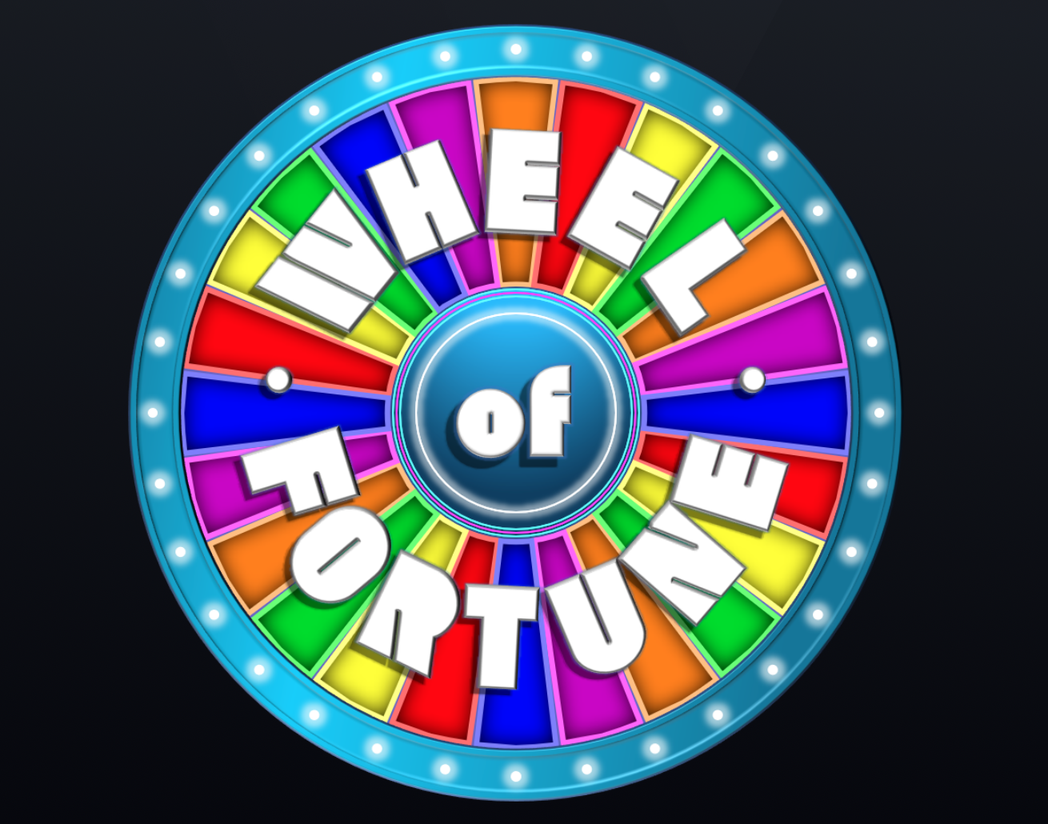
Notes:
To review, participants will play a game of Wheel of Fortune. Host will share his screen at the following link: https://www.triviamaker.com/game-preview/game/WF20220227164600346035212-Keys-to-Change
The host will then break participants into their Framework Teams. The teams will compete to guess the hidden phrase. Each team will take turns spinning the wheel to guess the letters of the puzzle, while accumulating points. Teams must guess the puzzle after selecting a letter. The first team to correctly guess what the hidden phrase is wins!

Slide 25
ROSE & THORN REFLECTION
Notes:
Participants will volunteer to share their roses (things they enjoyed) and thorns (things that they did not enjoy) about today’s workshop, and offer suggestions for improvement.

Slide 26
FEEDBACK
Please visit the following link to provide your anonymous feedback.
https://docs.google.com/forms/d/1W1FypS7TNIKXbnrs5YuTCVrQgLtU_qf2q7R2i1lot_0/edit
Please respond critically and honestly, as doing so will help us to improve. Note that the feedback form is organized into three categories: 1. Exercises 2. References/Resources and 3. Facilitation.
Notes:
Facilitator will drop the link in the chat so that participants can provide their feedback:
https://docs.google.com/forms/d/1W1FypS7TNIKXbnrs5YuTCVrQgLtU_qf2q7R2i1lot_0/edit

Slide 27
RESOURCES
• Creating Father-Friendly Environments in Early Childhood Programs https://eclkc.ohs.acf.hhs.gov/sites/default/files/pdf/bt5-feg-creating-father-friendly-environments-in-early-childhood-programs.pdf
• Engaging Fathers in Head Start https://www.fatherhood.gov/sites/default/files/resource_files/e000001785.pdf
• Father Engagement in Human Services https://www.mathematica.org/publications/father-engagement-in-human-services
• Head Start Parent, Family, and Community Engagement Framework: An Overview for Parents https://eclkc.ohs.acf.hhs.gov/sites/default/files/pdf/hs-pfce-framework-overview-for-parents-eng.pdf
• How Fatherhood Programs Supported Dads During the Pandemic https://www.mathematica.org/blogs/how-fatherhood-programs-supported-dads-during-the-pandemic
• Professional Development Strategies That Promote Father Engagement https://eclkc.ohs.acf.hhs.gov/sites/default/files/pdf/bt5-feg-professional-development-strategies-promote-father-engagement.pdf
• Program Strategies to Maximize Fathers’ Connections With Community Partners https://eclkc.ohs.acf.hhs.gov/sites/default/files/pdf/bt5-feg-program-strategies-maximize-fathers-connections-community-partners.pdf

Slide 28
RESOURCES (continued)
• Program Strategies to Promote Father Engagement in Their Children’s Teaching and Learning https://eclkc.ohs.acf.hhs.gov/sites/default/files/pdf/bt5-feg-program-strategies-promote-father-engagement-childrens-teaching-learning.pdf
• Program Strategies to Provide Access and Continuity of Services to Fathers https://eclkc.ohs.acf.hhs.gov/sites/default/files/pdf/bt5-feg-program-strategies-provide-access-continuity-services-fathers.pdf
• Responses from needs assessment (https://docs.google.com/forms/d/118KjOPQAkcG4aCgGXIxa9JME_8TGJg5wgJIyTrFuCeQ/edit#responses)
• Seven Steps for Conducting a Successful Needs Assessment https://www.nichq.org/insight/seven-steps-conducting-successful-needs-assessment
• Strategies for Program Leaders to Support Father Engagement https://eclkc.ohs.acf.hhs.gov/sites/default/files/pdf/bt5-feg-strategies-for-program-leaders-support-father-engagement.pdf
• Strategies to Build Partnerships with Fathers https://eclkc.ohs.acf.hhs.gov/sites/default/files/pdf/bt5-feg-strategies-to-build-partnership-fathers.pdf
• The Community Change Model Blueprint https://communitychangeinc.com/wp-content/uploads/2019/09/9a.-The-Community-Change-Model.pdf

